Slide 1



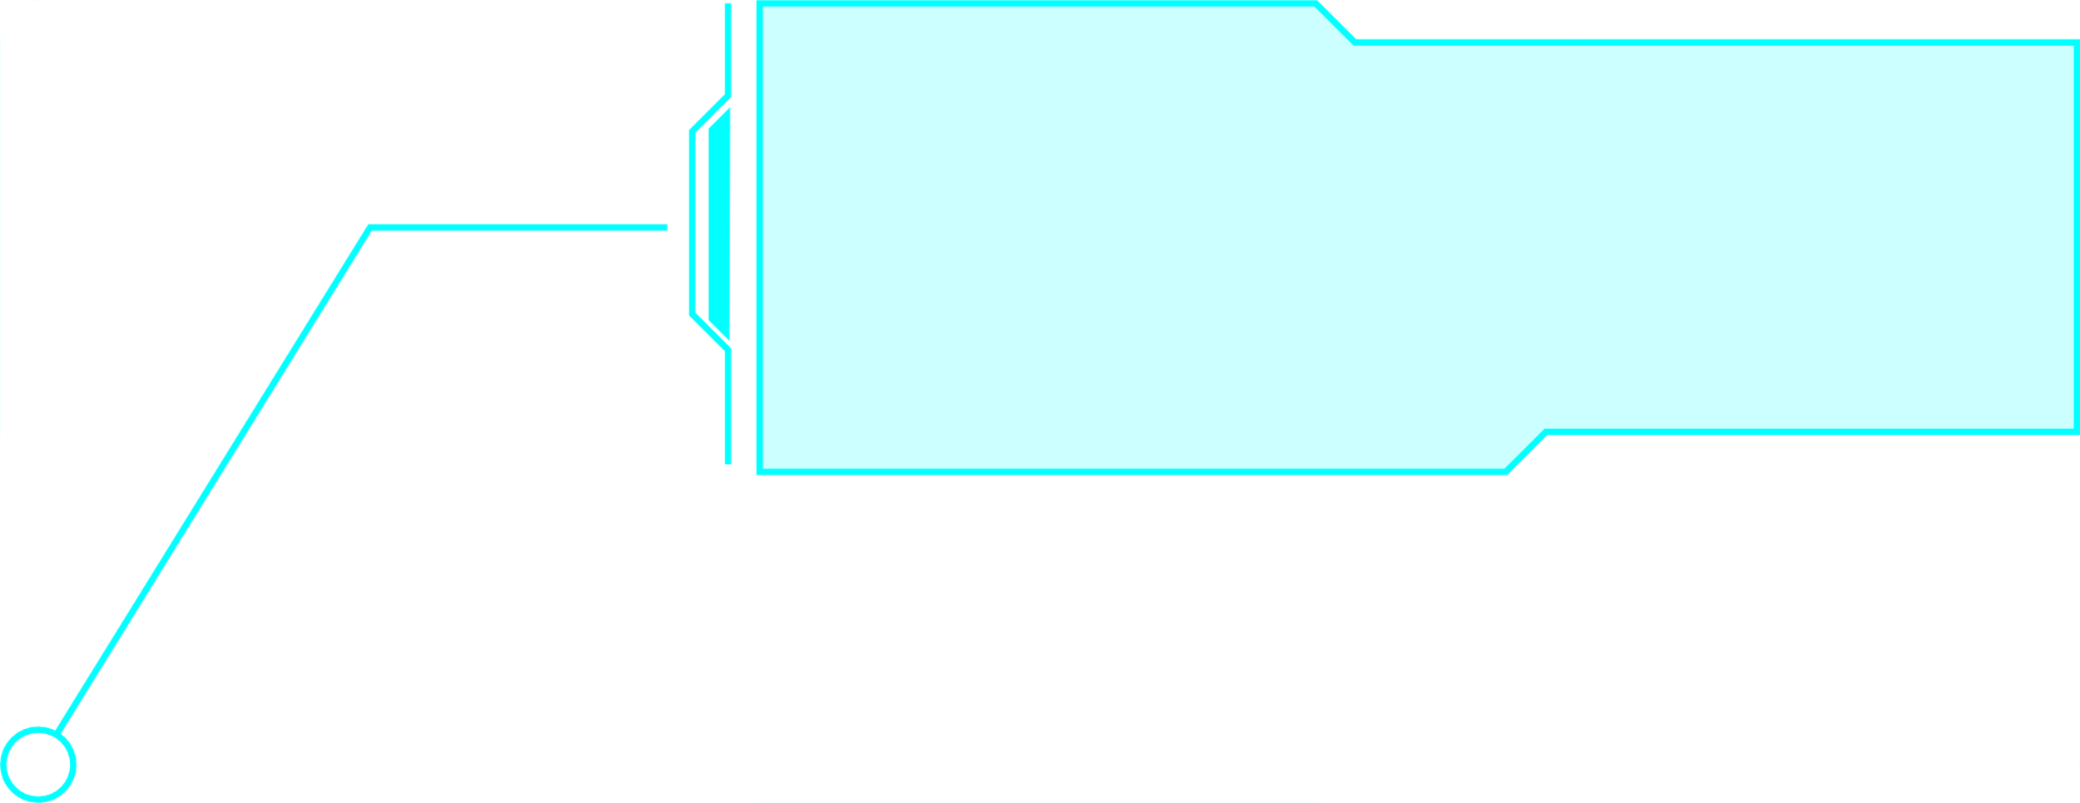
HOME
NEWS
ABOUT
Archimedes Technologies (ArchiTec)
ARCHITEC SCHOOL
SYSTEM

Slide 2
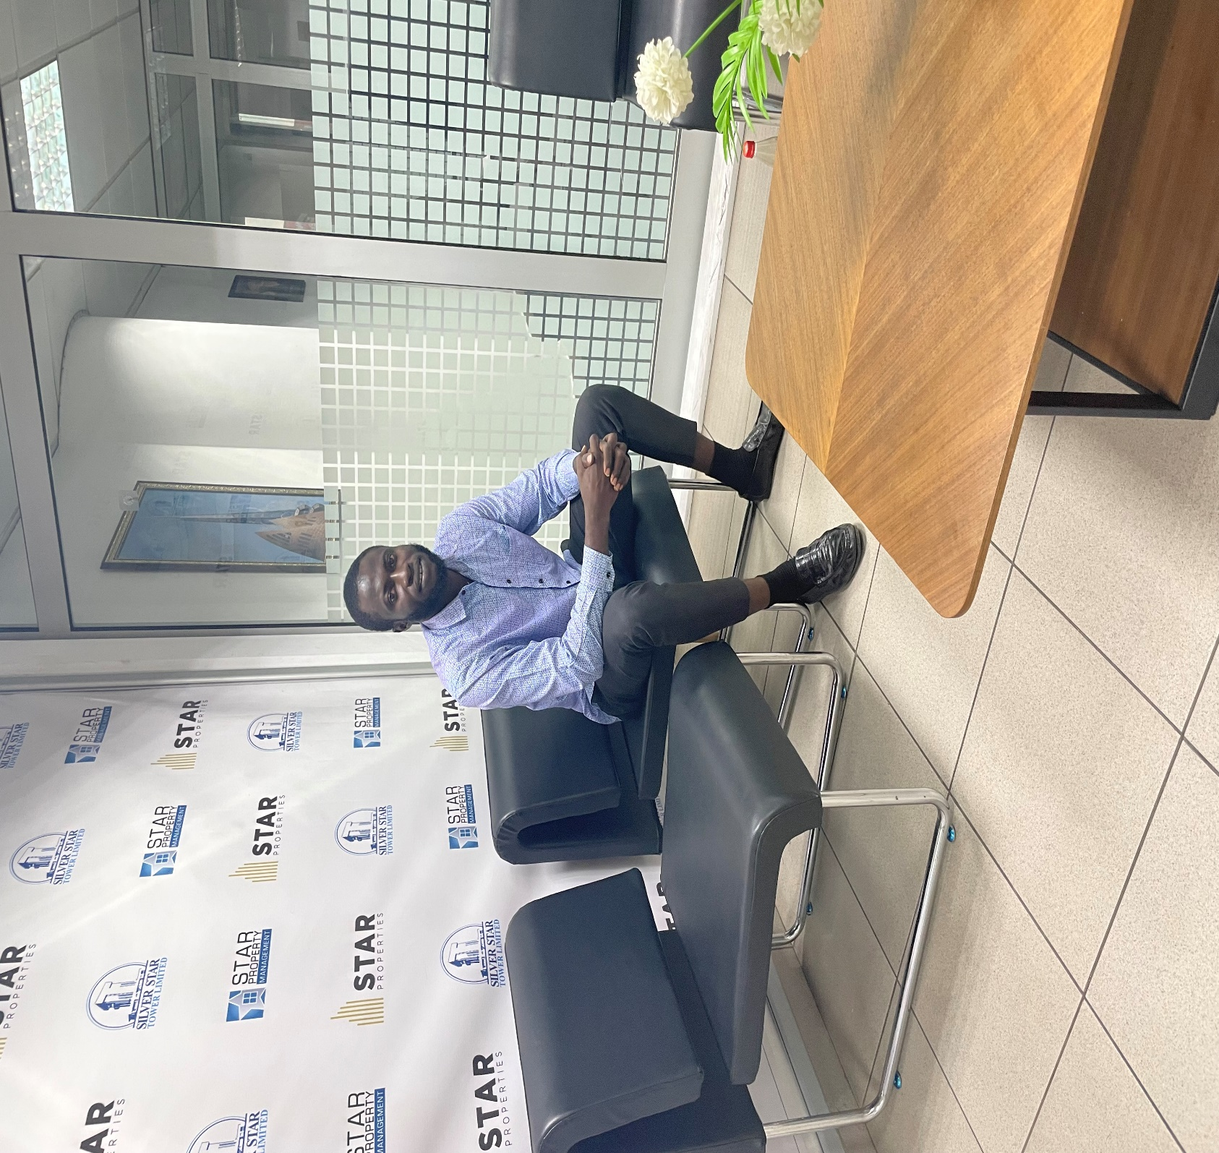
HOME
ABOUT
MORE
INTRODUCTION
I am Saeed Mustapha(Archimedes), a graduate of UCC.
I studied Bsc. computer science
I am currently a teacher at Tawheed Educational Center.
I am a web developer, graphic designer, data sales agent and an author.
I believe technology should not just exist--it should solve real problems and make life easier

Slide 3
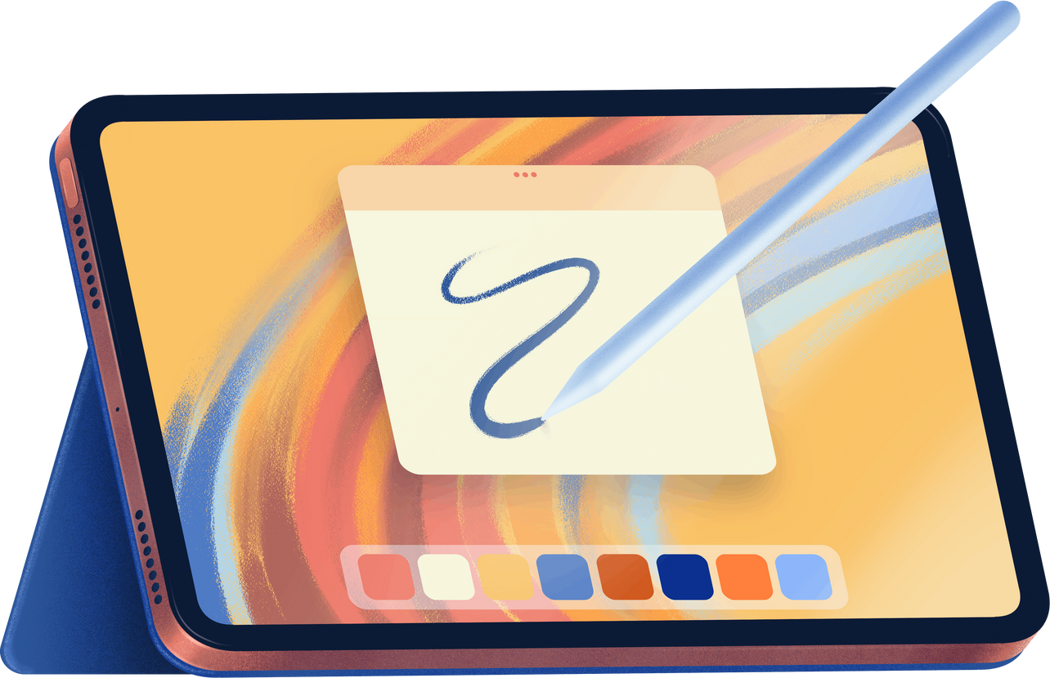
HOME
ABOUT
MORE
1. Teachers had to physically sign in with a pen in a book where some teachers may manipulate their signing time.
2. Lesson plans submitted on paper to the headmaster; manual marking/approval. What if admin is not in school but still want to carry out this task?
3. Announcements given verbally, on notice boards, or with delays.
4. Teaching resources shared physically or sometimes hard to access.
5. Go through sign book before knowing the teachers that was in school on a particular day and time teachers reported. What if administrator is not in school but still want access to this information?
.
LIFE BEFORE ARCHITEC SCHOOL SYSTEM

Slide 4
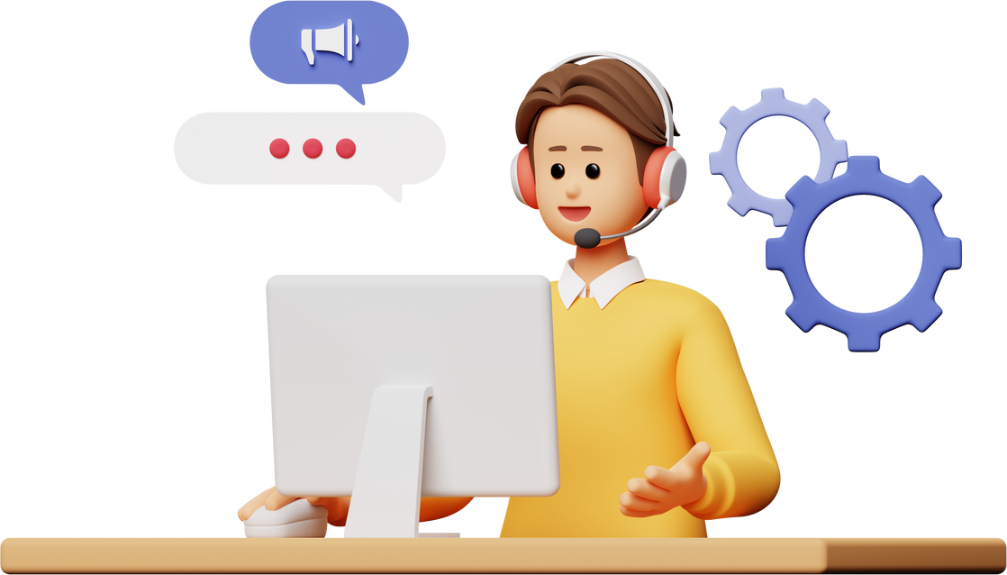
HOME
ABOUT
MORE
THE TRANSFORMATION
Digital signing: teachers log in, sign, timestamp recorded automatically (early/late clearly marked).
2. Lesson plans submitted online; Administrator reviews, mark and comment with just clicks.
3. Announcements sent instantly online to teachers, students, or both with one click.
4. Resources uploaded by admin; teachers download anytime, anywhere.

Slide 5
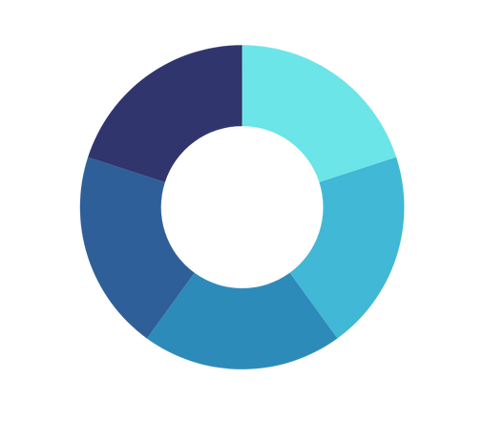
HOME
ABOUT
MORE
KEY FEATURES
Mobile view
Desktop view
Mobile responsiveness
User-friendly navigation
PDF and image download support
Clean User interface
Mobile responsiveness
User-friendly navigation
PDF and image download support
Clean User interface.

Slide 6

One Step Ahead
HOME
ABOUT
MORE
Our website goes beyond the normal information reading websites you find everywhere. While most educational websites provide reading materials and basic updates, we have added powerful tool that makes difference
Normal reading content: Access information, resources and updates just like other sites
Teacher and Administrator Portal: A secure system for digital signing, lesson plan submission and marking, as well as resource sharing
Seamless Communication: Send announcements to only teachers, only the public or both in just few clicks
Integrated Experience: Combines learning, management and communication into one platform

Slide 7
HOME
ABOUT
MORE
DEMO

Slide 8

HOME
ABOUT
MORE
THANK YOU
www.archimedes.vercel.app
(0558652422)

